Slide 1


SOFE 3980U
Software Quality
Course Project
Improving quality of a legacy software
Group 14
Fawwaz Khayyat
Anwar Almukhtar
Saleh Nawar
Christian MacLeod

Slide 2
Outline
Introduction
Testing Methodology
Fix Examples
Test Cases Example

Slide 3
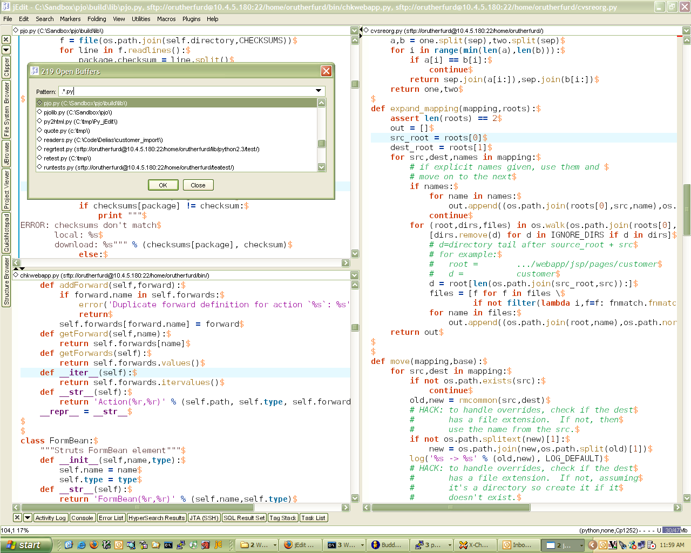
Introduction
jEdit is a mature programmer's text editor
Some of jEdit's features include:
Written in Java
Copy and paste with an unlimited number of clipboards (known as "registers")
Rich set of keyboard commands for manipulating entire words, lines and paragraphs at a time
Plug-ins to customize the application for individual use

Slide 4
Testing Methodology

Slide 5

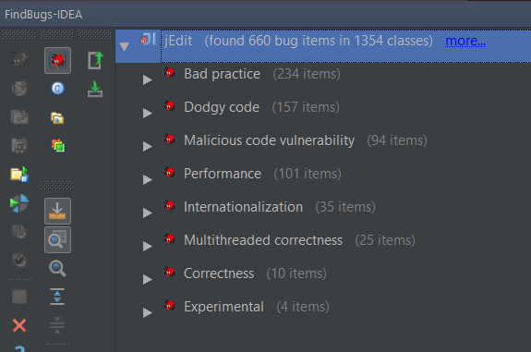

To not break the relationship between the functions and/or classes:
We avoided bugs related to best practices that might change the function or class declaration.
Notes:
We addressed some of those bugs. We avoided bugs related to best practices that might change the function or class declaration. To not break the relationship between the functions and classes.

Slide 6

In order not to break the relationship between functions and classes, we followed these steps:
Write test cases
Test
Modify
Test
We used the test cases to test for Small modifications in the classes.
Test Data where selected manually
Notes:
for void functions, we needed to create getters for private variables

Slide 7
Fix Examples

Slide 8
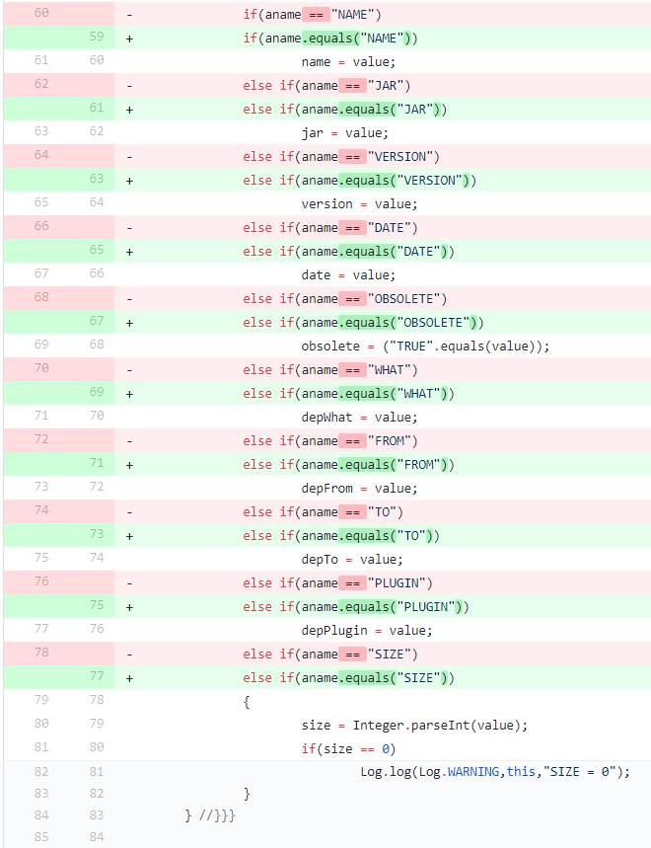
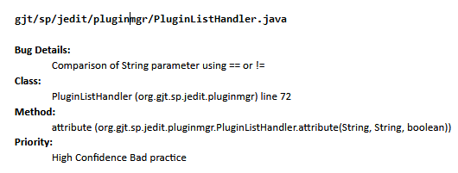
Notes:
Comparison of String objects using == or !=
This code compares java.lang.String objects for reference equality using the == or != operators. Unless both strings are either constants in a source file, or have been interned using the String.intern() method, the same string value may be represented by two different String objects. Consider using the equals(Object) method instead.

Slide 9
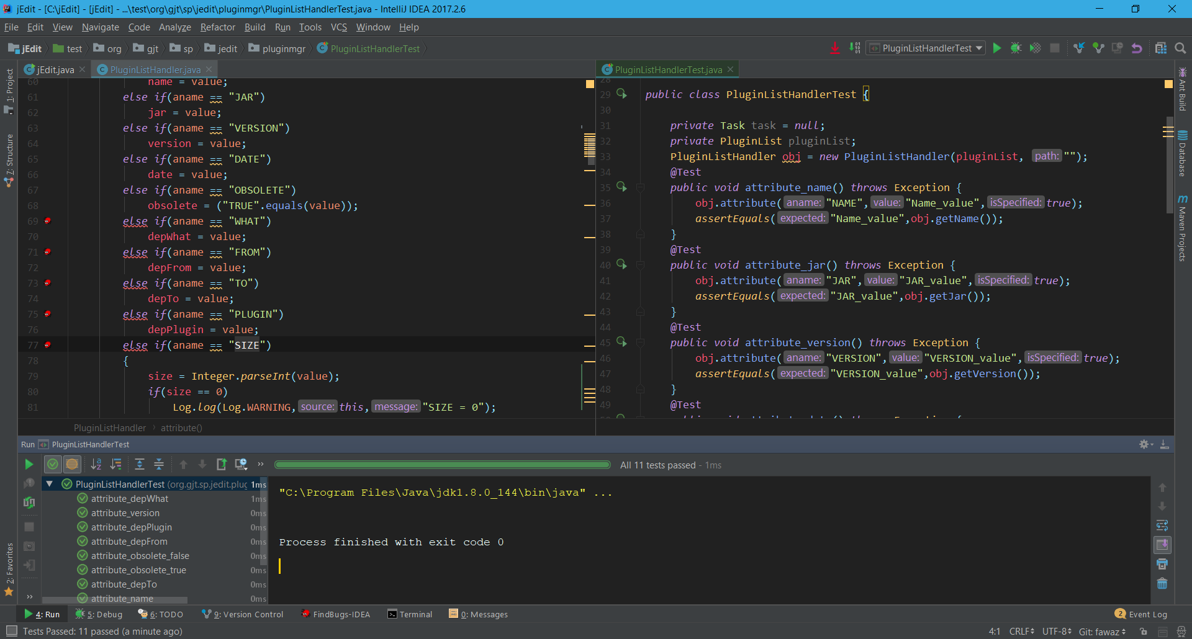
Testing before & after changing the code

Slide 10
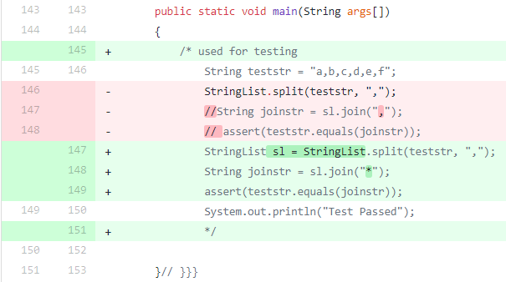
Code for testing with error
gjt/sp/util/StringList.java
Bug Details:
Return value of split(String, Object) ignored, but method has no side effect
Class:
StringList (org.gjt.sp.util) line 146
Method:
main (org.gjt.sp.util.StringList.main(String[]))
Priority:
Medium Confidence Dodgy code
Comments:
The code in the main function is used to test split and join functions. The code run without error because part of the code is commented. If we uncomment the code, it will produce errors. That is because of missing sl variable storing the return value of the splitted string..
Notes:
Return value ignored
“Test Pass” will alway print

Slide 11
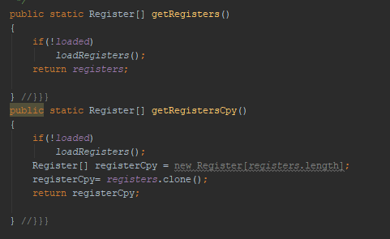
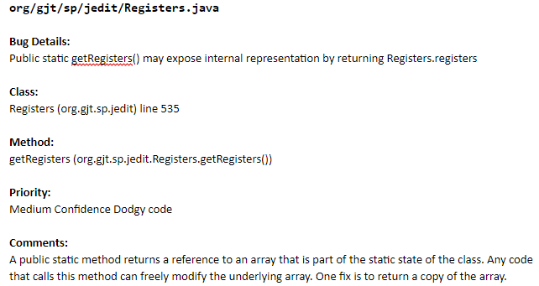
Test case 2

Slide 12
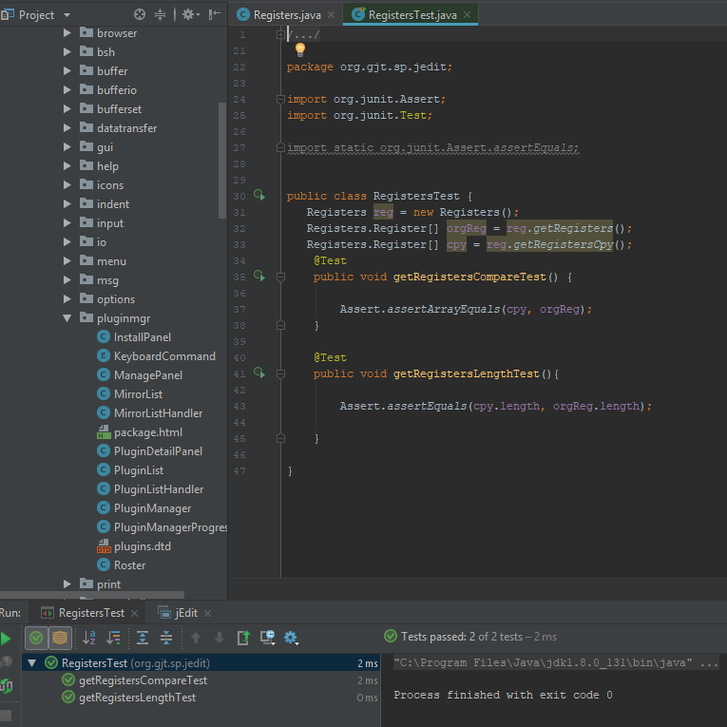

Slide 13
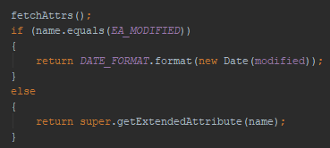
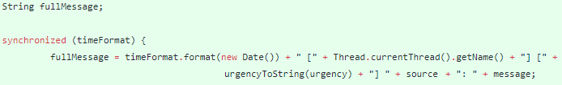


Multithreaded Correctness
Sun Bug #6231579 and Sun Bug #6178997:
Call to static DateFormat
Calling Locations:
org.gjt.sp.jedit.io.FileVFS$LocalFile.getExtendedAttribute(String)
org.gjt.sp.util.Log._log(int, String, String)
Classification:
High Confidence Multithreaded Correctness
Fix Description:
Encapsulated the DateFormat objects in Java’s Synchronized() block, ensuring only one thread can access the object at a time
Original Code:
Fixed Code:

Slide 14
Improvements
Reliability
85 FindBugs hits were addressed and fixed
Approximately 222 open bugs on the Sourceforge bug tracker
Security
Reliance on proper calling of the method functions. Defensive coding & sanity checks will reduce possibility of system entering error state
Standards Compliance
Comments in the code indicate that the coder is unsatisfied with the coding style used. Refactoring can be done to bring it into compliance with existing Java standards

Slide 15
References
http://jedit.org/
https://www.jetbrains.com/idea/
http://findbugs.sourceforge.net/
https://sourceforge.net/p/jedit/bugs/

